Slide 1




Proven, Pragmatic Applications of Artificial Intelligence in Safety Reporting
Steven Beales,
SVP, WCG Scientific and Regulatory
Notes:
Thank you all for coming here today. Only the best people in any field take the time to come so far for a conference like this and stay to the very end.
You’re going to enjoy the time we spend together this afternoon and not just because of the free lunch. I will share with you some of the most important ideas that have ever been discovered in Global Safety Reporting.
I’ll be introducing you to the Safety Reporting Reference Model and the Artificial Intelligence that’s used to operationalize and maintain it.

Slide 2

Meet Today’s Speaker
Steven Beales
SVP, WCG Scientific and Regulatory
20+ Years in Clinical Research
Passionate about Patient Safety and Intelligent Safety Reporting
Notes:
Hi I’m Steven Beales, and I lead scientific and regulatory technology at WCG. From my accent, you may be able to tell I spent the first half of my life in UK and second half in US, so I wake up each morning and wait to see which government is going to embarrass me most today. It’s usually a close call.
I’ve been in clinical research over 20 years and for more than half that time I’ve specialized in the intelligent delivery of safety reports. I’ve helped create systems that have now delivered over 200+ million safety notifications at biopharma ranging from the largest to the emerging.

Slide 3




Regulatory Challenges with Global Safety Reporting
No Standards
Unclear Regulations
Conflicting Interpretations
Notes:
What’s the biggest challenge we face with Global Safety Reporting? That there are no standards for distributing safety reports globally to investigators, ethics committees, and regulatory.
Over the last 10 years, we have discovered over 40 distinct patterns of distributing responsibility for patient safety across investigators, regulatory authorities, IRBs, and Sponsors.
Each Biopharma then interprets local country rules themselves to decide what safety information to generate and distribute in each country.

Slide 4



Compliance Consequences of Lack of Global Harmonization
Regulatory Repercussions
Fractured Accountability
Increasing Trial Complexity
Notes:
As clinical research becomes more global, the number 1 safety reporting problem for sponsors is the fear of regulatory repercussions because rules and practices vary from country to country.
Most sponsor affiliates are not fully in compliance with their local country regulations. Sponsors discover this during inspections when they can produce little evidence the latest approved safety information was distributed to investigators and ethics committees prior to administering drug to patients during a trial. It’s the most common safety reporting finding.
To raise the urgency of acting now, trials are only getting more complex - at 2 sponsors we work with, we’ve seen a 571% increase in SUSAR volume over 2 years as they moved their portfolio towards oncology.

Slide 5



Burden on Clinical Trial Sites
Too Many Reports
Duplicate Reports
Overly Time-consuming
Too Many Websites
Useful Information Hidden
Notes:
How does this effect sites? Sites are overwhelmed with over-reported and cross-reported safety reports due to “brute-force” distribution.
Many companies still distribute all safety reports to all Sites and Ethics Committees instead of observing local laws, sending an average of 2.7 copies of each SUSAR to an investigator who is working on multiple studies on same compound.
20% of sites have now refused to process a SUSAR because it was an over-distribution.

Slide 6
Site Spending on Safety Reporting
Cost to Sponsors - $1bn per year
Notes:
Every year since 2010, the number of expedited safety reports submitted by each investigator has gone up.
80% sites receive more than 20 SUSARs per month.
61% sites spend more than 80 hours of staff time on processing IND Safety Reports each month.
The cost to sponsors is about $1billion per year.

Slide 7

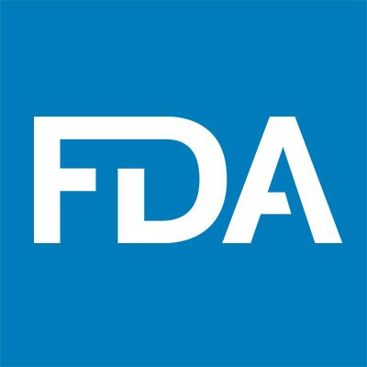



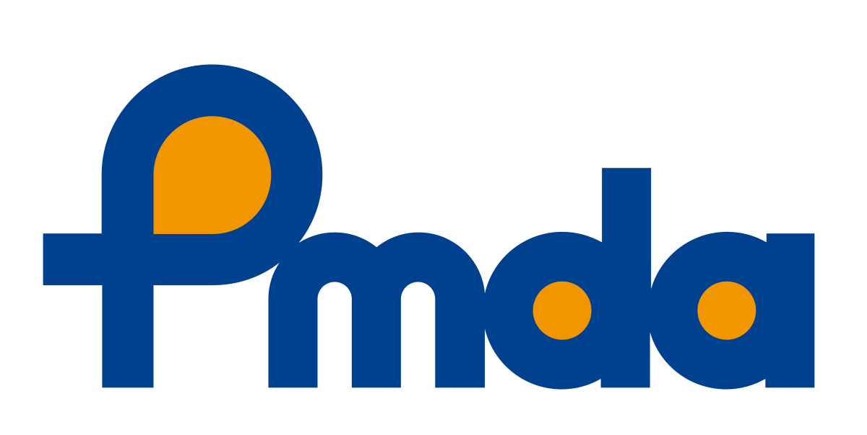
Safety Reporting Harmonization Working Group
Top 1 US Pharma
Top 1 EU Pharma
Top 1 US IRB
Top 1 US CRO
Top 2 Japan Pharma
Top 3 US Biotech
Notes:
I co-chair the Safety Reporting Harmonization Working Group with experts from many of the leading companies in our industry.
We meet twice a year to discuss the latest changes in global safety reporting rules and the recommended best practice interpretations.
Although the laws do not change frequently in each country, we see best practice interpretations changing in 1-2 countries per month.
The output of these meetings is a reference model of global safety reporting rules that is executable by an AI.

Slide 8
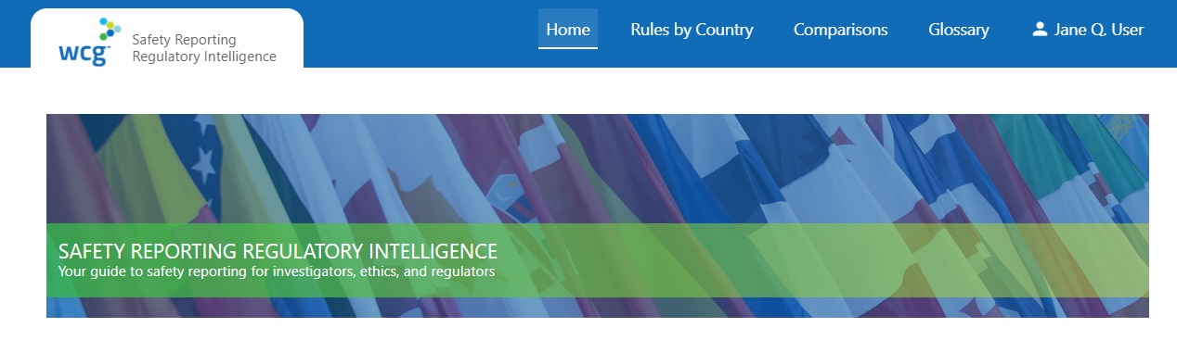

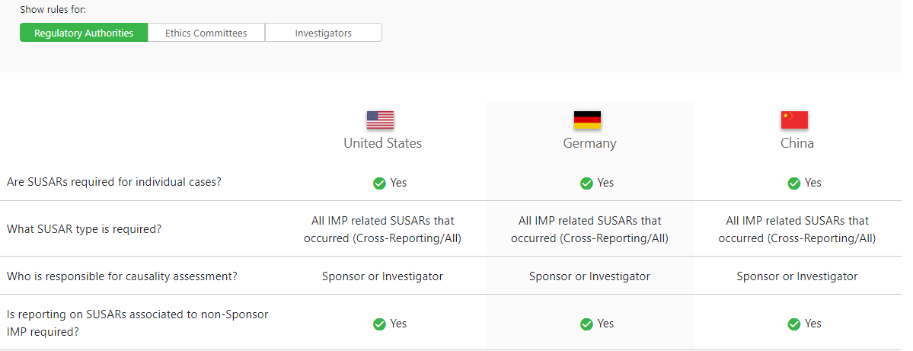
Safety Reporting Reference Model
Safety Reporting Regulatory Intelligence - Made available in a portal managed by Working Group
125 Countries
Safety Reporting
Regulatory Intelligence
Notes:
We have published our work in a regulatory intelligence portal that contains the safety reporting reference model for 125 countries and 63 different types of local rules.
The safety reporting reference model consists of
Safety Document Characteristics e.g. SUSARs, Reference Safety Information
Country Characteristics e.g. Unblinding requirements, Ethics Committee, Regulatory Authority and Investigator reporting requirements
Oversight and Procedures e.g. Translation of regulations into checklists and operational steps
We publish updates to this model every 3 months.

Slide 9


Safety Reporting Reference Model – How is it Maintained?
Artificial Intelligence
Monitor Regulatory changes
Regulations, guidance and directives
Natural Language Processing
Text Summarization
Text Classification
SafetyPortal metrics and analytics
200 million records
Human Expertise
Safety Reporting Harmonization Working Group and Affiliates
Changes in interpretation of rules
Safety Reporting Reference Model updates
Notes:
To maintain our model, we use Natural Language Processing to summarize and classify over 100 feeds of regulatory information.
The ability to extract the most important 6 lines as a summary from guidance has been invaluable in cutting the time to support this resource intensive activity by over 80%.
Building on work of the Aeolus project to match different safety and clinical terminology concepts and product names across countries is also essential to this effort.
For the data scientists amongst you this is all done using Word2VEC and TF-IDF. We plan to begin using BERT later this year.

Slide 10

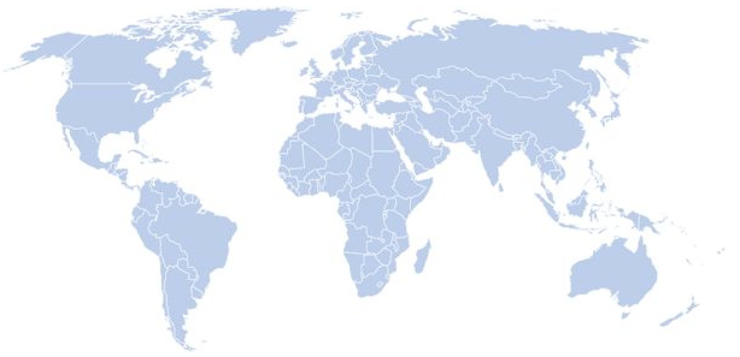

SafetyPortal - Safety Reporting Artificial Intelligence
Precision
Distribution
100k Safety
Reports
200m Safety
Notifications
Safety
Reference
Model
Notes:
Over the past 3 years, 2 of top 3 pharma and 1 of top 2 CROs amongst many others, have been using this regulatory intelligence to launch a dynamic data driven, rules-based Artificial Intelligence that uses the safety reference model to power precision distribution to sites, ECs and RAs in over 100 countries.
The AI considers causality, unblinding, RSI, cross reporting, country, site and EC rules to make its reporting decisions.
As of now, these systems will have sent over 100k SUSARs and over 200m safety letters.
Inspection Readiness Is at the core of the design – the system always distributes according to local laws and alerts those responsible in real time if there is a transmission failure and a risk of sites/IECs not getting timely information.

Slide 11

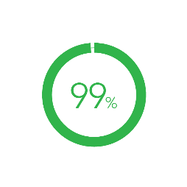
Big Data – 100s of Millions of Records per Year
Costs
Avoided
Sites in Compliance
Reduction in Site Burden
175 - 450k
per trial
10 hours
per week
Notes:
We have a huge dataset to mine that keeps growing. The results achieved so far have exceeded expectations.
People are rightly skeptical that these results are a best case and not achievable for most companies. I will add a few caveats to these results.
Firstly, we’ve been working on problem for 10 years. It didn’t happen overnight,
Secondly, the most difficult exercise is the change management to transform your organization to adopt best practices in safety reporting.
Thirdly, your organization will need to clean its clinical trial data to achieve the results shown.
What drives the cost and time savings is the fact that 70% of safety letters are eliminated by using best practice regulatory intelligence.

Slide 12

Site Experience and Testimonials
“System is seriously phenomenal compared to other sponsor’s pharmacovigilance systems”
Notes:
What drives the site acceptance has been the huge effort made to give sites the best experience and 1 click access to safety information.
This is an unsolicited testimonial that one of our sponsors received from a leading US academic medical.
We plan to make further use of AI to organize the safety information by medical ontology so investigators can find the relevant safety information for their patient quickly rather than reading through pages of literature.

Slide 13



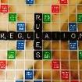


A look back in time…
A journey in safety reporting……
Early days!
2006
2019 and Beyond!
2010
Email for sending documents!
2017
You’ve got mail!
You’ve got email!
Put it in a portal
Rules and Regulations
Process and System alignment
Industry issue
Notes:
Most sponsors are at the start of their safety reporting journey. Safety reporting is not just a drug safety issue – most of the headache falls on clinical operations reporting to sites and ethics committees.
If this pain is yours, you are in the fortunate position of being able to take advantage of latest technology and decades of acquired industry knowledge to leapfrog to a place that allows you to rest easy at night – knowing that your global compliance worries, high manual efforts and high costs of trying to maintain compliance could be almost eliminated.

Slide 14

Time For Action
Notes:
Change is never painful, only resistance to change is painful. I hope many of you will join us in building the safety reporting reference model and being a pragmatic clinical operative.

Slide 15
Ask Big Questions
Notes:
Thank you for listening.

Slide 16

Thank You!
Follow-up questions?
Contact Steven Beales at: sbeales@wcgclinical.com
610-834-6209

